Slide 1

Comp90042
Workshop
Week 6
25 April

Slide 2
Table of Content
Lexical Semantics
Distributional Semantics

Slide 3
Question 1
Give illustrative examples that show the difference between:
(a) Synonyms and hypernyms
(b) Hyponyms and meronyms
The relationships between words meanings

Slide 4
Synonyms
Synonyms: words share (mostly) the same meanings
snake and serpent
snake
Synonyms
serpent

Slide 5
Synonyms vs Hypernyms
Synonyms: words share (mostly) the same meanings
snake and serpent
Hypernyms: One word is a hypernym of a second word when it is a more general instance (“higher up” in the hierarchy) of the latter
reptile is the hypernym of snake (in its animal sense)
reptile
Hypernyms
snake

Slide 6
Hyponyms vs Hypernyms
Hypernyms: One word is a hypernym of a second word when it is a more general instance (“higher up” in the hierarchy) of the latter
reptile is the hypernym of snake (in its animal sense)
Hyponyms : One word is a hyponym of a second word when it is a more specific instance (“lower down” in the hierarchy) of the latter
snake is the hypernym of reptile(in its animal sense)
reptile
snake
Hyponyms

Slide 7
Hyponyms vs Meronyms
Hyponyms : One word is a hyponym of a second word when it is a more specific in- stance (“lower down” in the hierarchy) of the latter
snake is the hypernym of reptile(in its animal sense)
Meronyms : One word is a meronym of a second word when it is a part of the whole defined by the latter
scales (the skin structure) is a meronym of reptile.
reptile
Meronym
scales

Slide 8
Exercise
Movie and Film
Hand and Finger
Furniture and Table

Slide 9
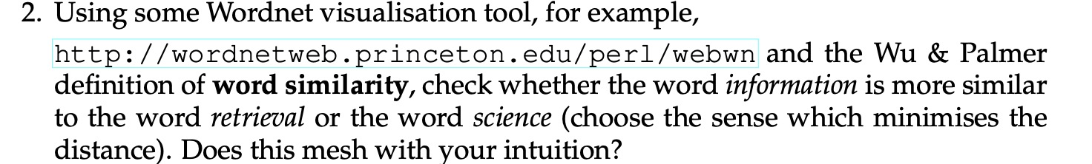
Question 2

Slide 10
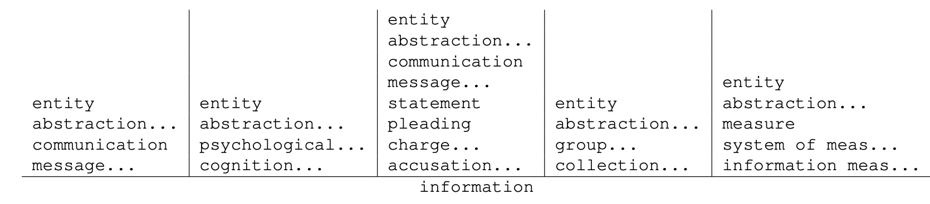
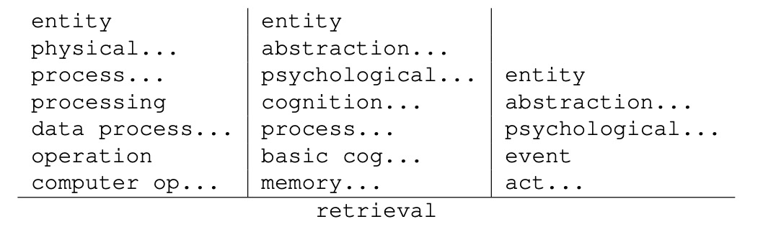
Wordnet

Slide 11
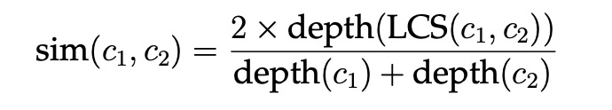
Word Similarity
Wu & Palmer similarity
LCS: lowest common subsumer
Depth: path length from node to root

Slide 12
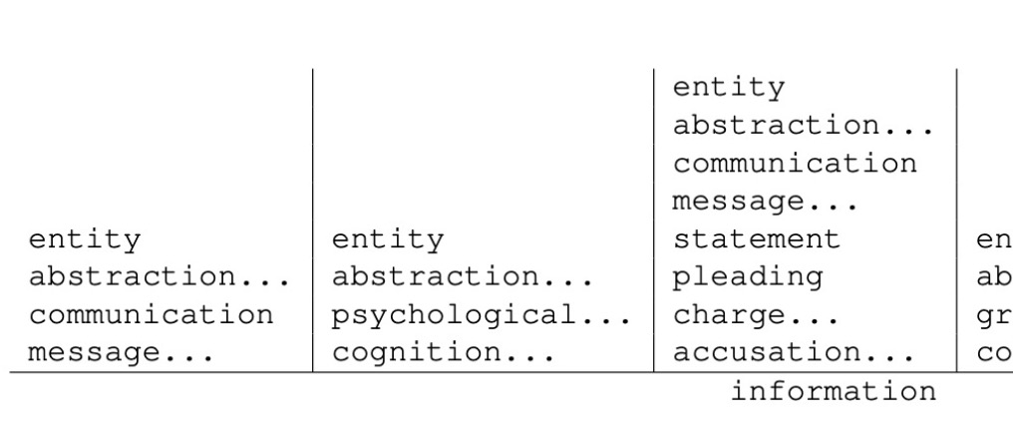
Wordnet
Choose the first meaning of two words
Depth(information) = 5

Slide 13
Wordnet
Choose the first meaning of two words
Depth(information) = 5
Depth(retrieval) = ?

Slide 14
Wordnet
Choose the first meaning of two words
Depth(information) = 5
Depth(retrieval) = 8

Slide 15
Wordnet
Choose the first meaning of two words
Depth(information) = 5
Depth(retrieval) = 8
LCS(information,retrieval): ?

Slide 16
Wordnet
Choose the first meaning of two words
Depth(information) = 5
Depth(retrieval) = 8
LCS(information,retrieval): entity

Slide 17
Wordnet
Choose the first meaning of two words
Depth(information) = 5
Depth(retrieval) = 8
LCS(information,retrieval): entity
Depth(LCS) = ?

Slide 18
Wordnet
Choose the first meaning of two words
Depth(information) = 5
Depth(retrieval) = 8
LCS(information,retrieval): entity
Depth(LCS) = Depth(entity) = 1

Slide 19
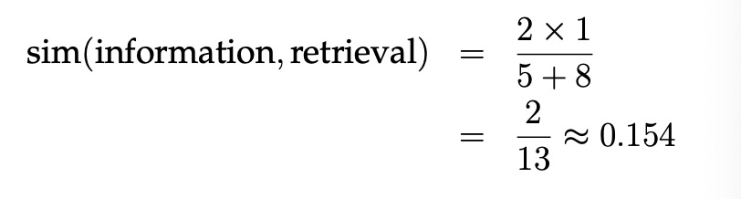
Wordnet
Choose the first meaning of two words
Depth(information) = 5
Depth(retrieval) = 8
LCS(information, retrieval): entity
Depth(LCS) = Depth(entity) = 1

Slide 20
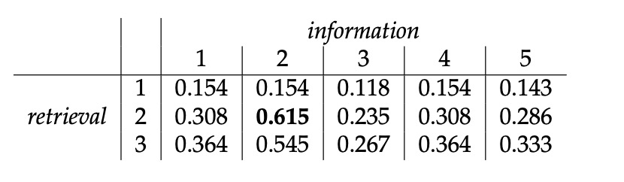
Similarity

Slide 21
Similarity
Try to calculate the similarity of information and science yourself
The maximum similarity is 0.727
sim(information, science) > sim ( information, retrieval)
Does this mesh with your intuition?

Slide 22

Question 3

Slide 23
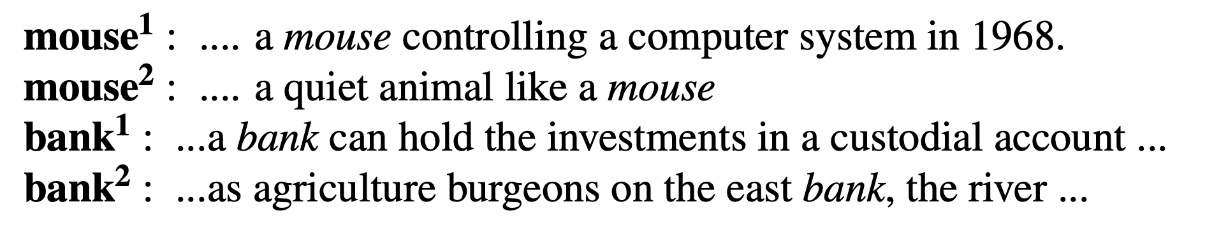
Question 3
Words can have multiple senses

Slide 24
Question 3
Words can have multiple senses
Word sense disambiguation
automatically determining which sense (usually, Wordnet synset) of a word is intended for a given token instance with a document.

Slide 25
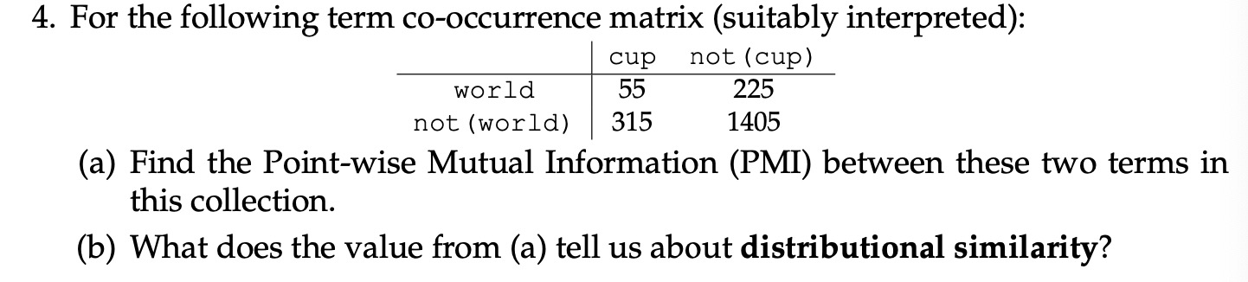
Question 4

Slide 26
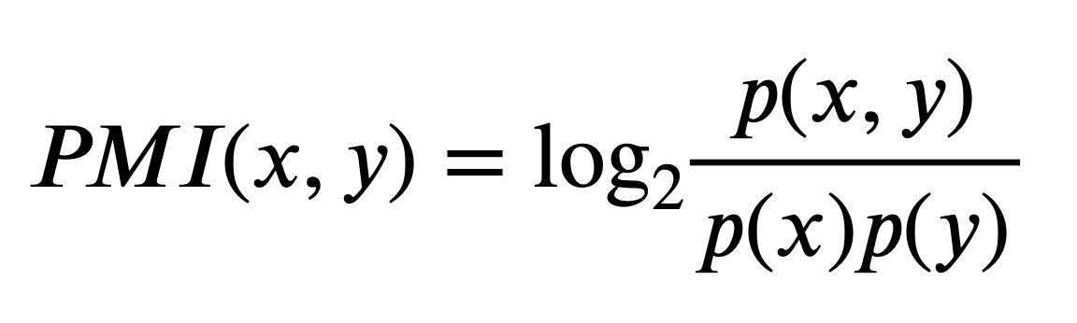
Point-wise Mutual Information (PMI)
represent how often two events co-occur
p(x,y) : joint distribution of x and y = count(x,y)/Σ
p(x): individual distribution of x. = Σx /Σ
p(y): individual distribution of y = Σy /Σ

Slide 27
Question 4
Total number of instance (Σ): 55+225+315+1405 = 2000

Slide 28
Question 4
Total number of instance (Σ): 55+225+315+1405 = 2000
P(world) = (55 + 225) / 2000 = 0.14

Slide 29
Question 4
Total number of instance (Σ): 55+225+315+1405 = 2000
P(world) = (55 + 225) / 2000 = 0.14
P(cup) = ?

Slide 30
Question 4
Total number of instance (Σ): 55+225+315+1405 = 2000
P(world) = (55 + 225) / 2000 = 0.14
P(cup) = (55 + 315) / 2000 = 0.185

Slide 31
Question 4
Total number of instance (Σ): 55+225+315+1405 = 2000
P(world) = (55 + 225) / 2000 = 0.14
P(cup) = (55 + 315) / 2000 = 0.185
P(w,c) = ?

Slide 32
Question 4
Total number of instance (Σ): 55+225+315+1405 = 2000
P(world) = (55 + 225) / 2000 = 0.14
P(cup) = (55 + 315) / 2000 = 0.185
P(w,c) = 55 / 2000 = 0.0275

Slide 33
Question 4
Total number of instance (Σ): 55+225+315+1405 = 2000
P(world) = (55 + 225) / 2000 = 0.14
P(cup) = (55 + 315) / 2000 = 0.185
P(w,c) = 55 / 2000 = 0.0275
PMI(w,c) = ?

Slide 34
Question 4
Total number of instance (Σ): 55+225+315+1405 = 2000
P(world) = (55 + 225) / 2000 = 0.14
P(cup) = (55 + 315) / 2000 = 0.185
P(w,c) = 55 / 2000 = 0.0275
PMI(w,c) = log2(p(w,c) / (p(w)*p(y))
= log2(0.0275 / (0.14*0.185))
≈ 0.0865

Slide 35
Question 4
PMI(w,c) ≈ 0.0865
Distributional similarity?

Slide 36
Question 4
PMI(w,c) ≈ 0.0865
Distributional similarity
slightly positive
occur together slightly more commonly than would occur purely by chance.
World Cup!

Slide 37
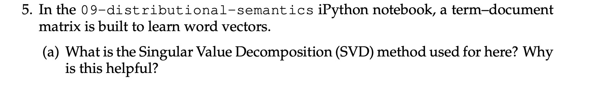
Question 5

Slide 38
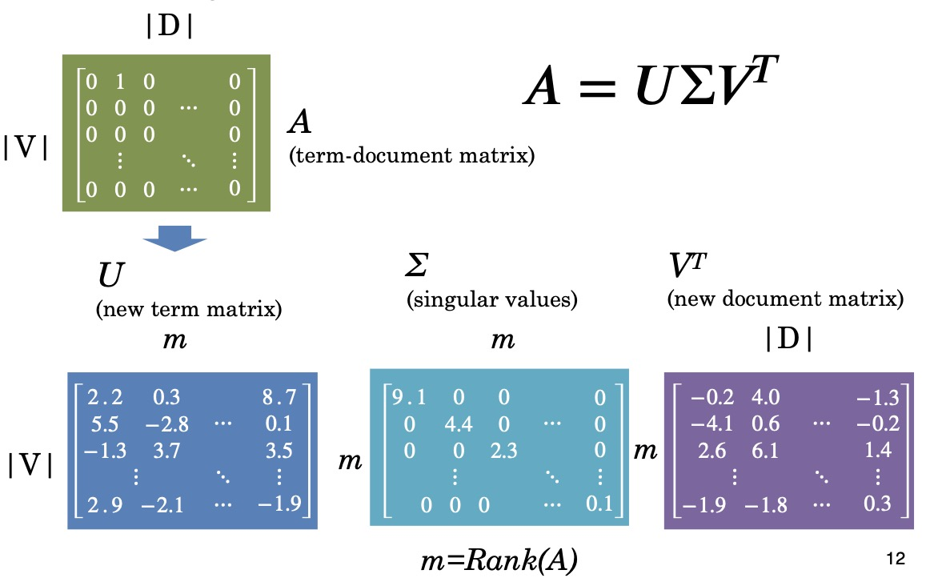
Singular Value Decomposition

Slide 39
Question 5
throw away the less important characteristics
identify the most important characteristics of word

Slide 40
Question 5
throw away the less important characteristics
identify the most important characteristics of word
create dense matrix
Save time and storage

Slide 41
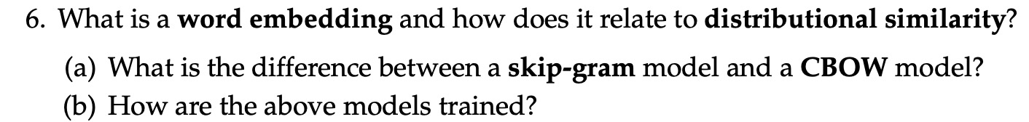
Question 6
Word embedding:

Slide 42
Question 6
Word embedding:
Representation of words into a vector space
Capture semantic and syntactic relationship between words

Slide 43
Question 6
Word embedding:
Representation of words into a vector space
Capture semantic and syntactic relationship between words
broadly the same as what we expect in distributional similarity

Slide 44
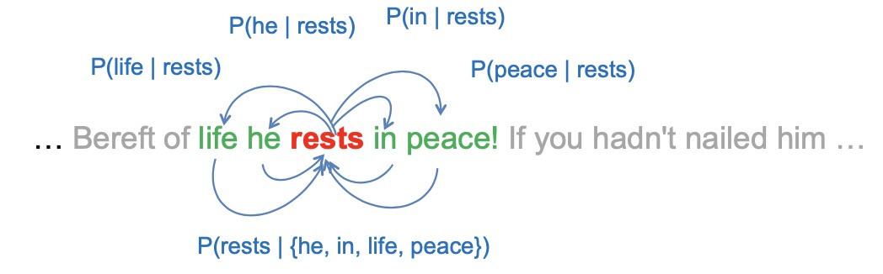
SG and CBOW

Slide 45
SG and CBOW
SG or CBOW?
SG or CBOW?

Slide 46
SG and CBOW
SG or CBOW
SG or CBOW

Slide 47
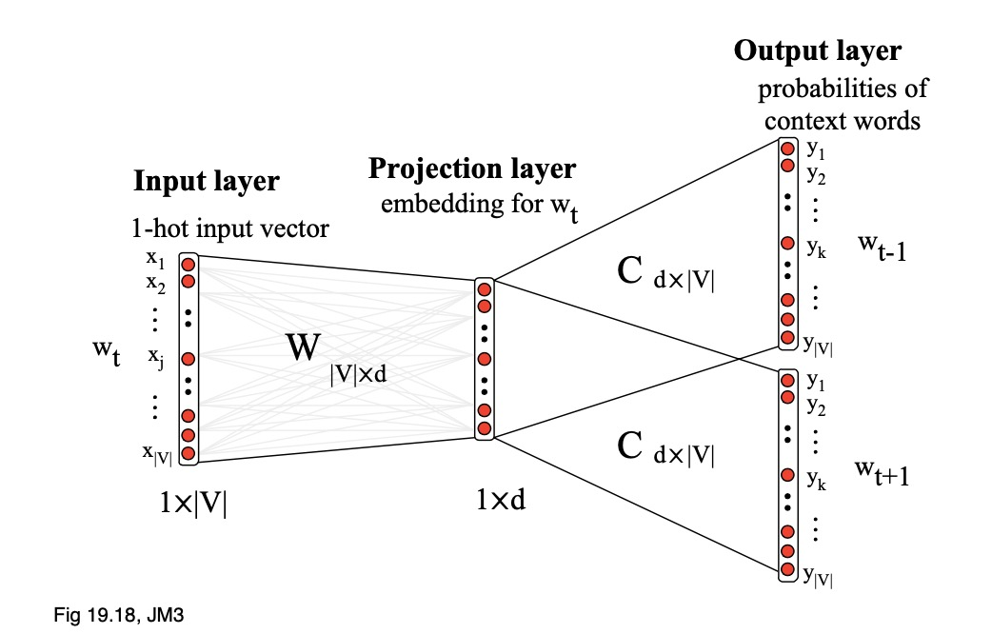
Training
Taking the dot product of the relevant vectors
Marginalising
Negative samples
Example of SG:

